Slide 1
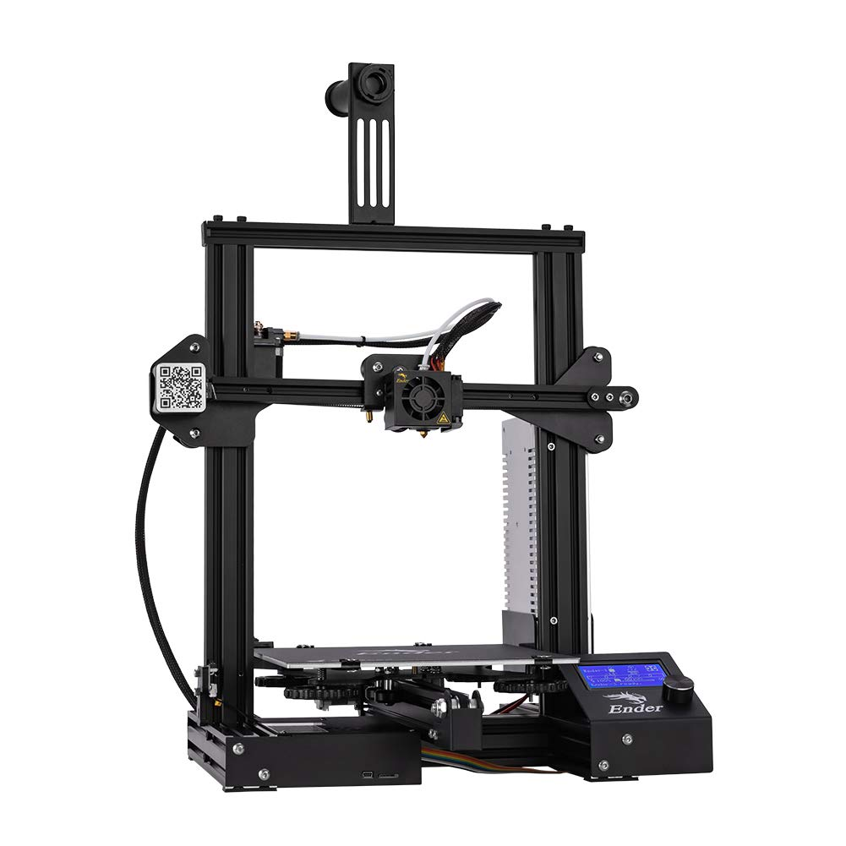

3D Printer and Application Interface Cody Hutchison
Steven Liu
Abigail Morar

Slide 2
Executive Summary
Problem Statement
Current 3D printers require the user to manually upload a G-code file by an external storage device and initiate the printing process via controls on the printer
Solution
The new 3D printer and Application will allow the uploading, controlling, and initiation of printing from anywhere with internet access
Quicker Z-axis motion
Print time within 10% of a regular Ender 3 Printer

Slide 3
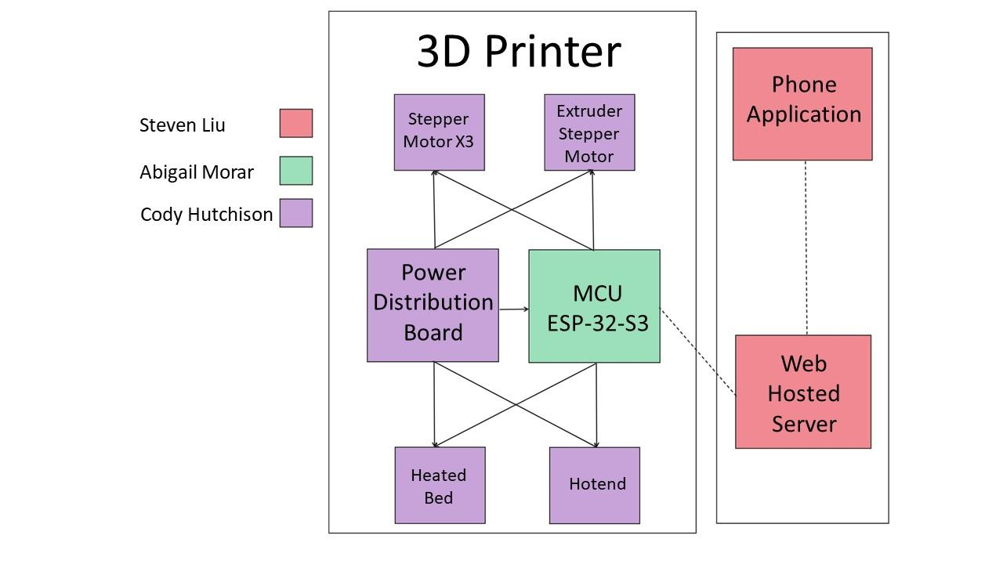
System Overview

Slide 4
Task Partition
Abigail: Program ESP32-S3
Cody: Design power distribution board, stepper motor, hotend, and heated bed controllers
Steven: Design and program the application and web hosted server

Slide 5
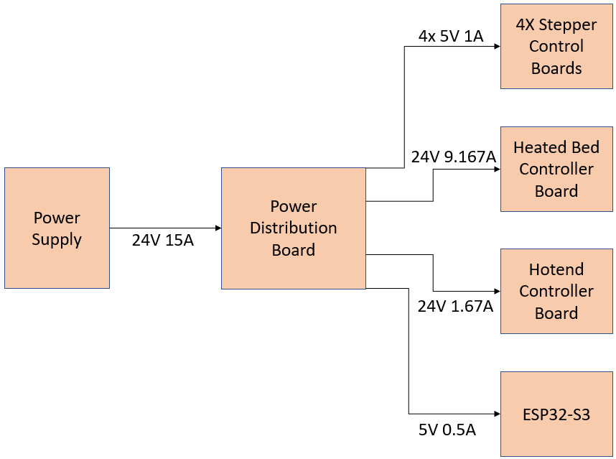
Electrical System Overview

Slide 6
Electrical System Overview
Power Distribution
Split 24V 15A into four 5V 1A outputs, a 5V 0.5A output, a 24V 9.167A output, and a 24V 1.67A output
Stepper Motor Drivers
Design 4 stepper motors drivers to control
Three at 5V 0.84A and one at 5V 1A
Hotend
N-Type MOSFET that takes MCU inputs and allows 24V 9.167A through
Heated Bed
N-Type MOSFET that takes MCU inputs and allows 24V 1.67A through

Slide 7
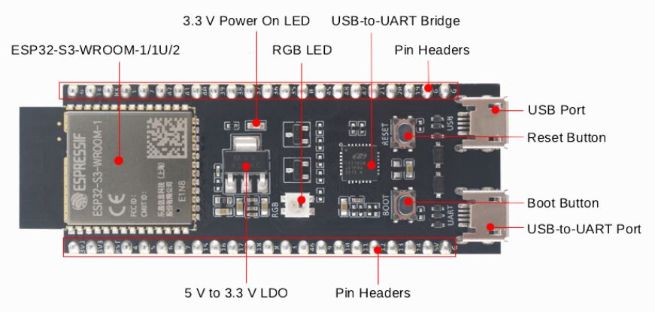
Microcontroller Unit
ESP32-S3
Connects all subsystems
Communicates to server
Controls all printer components

Slide 8
MCU Coding
Programmed in C
Reads in user input and files from application
Translates G-code to printer
Controls heating elements and stepper motors
Drives extruder
Links device to the internet

Slide 9
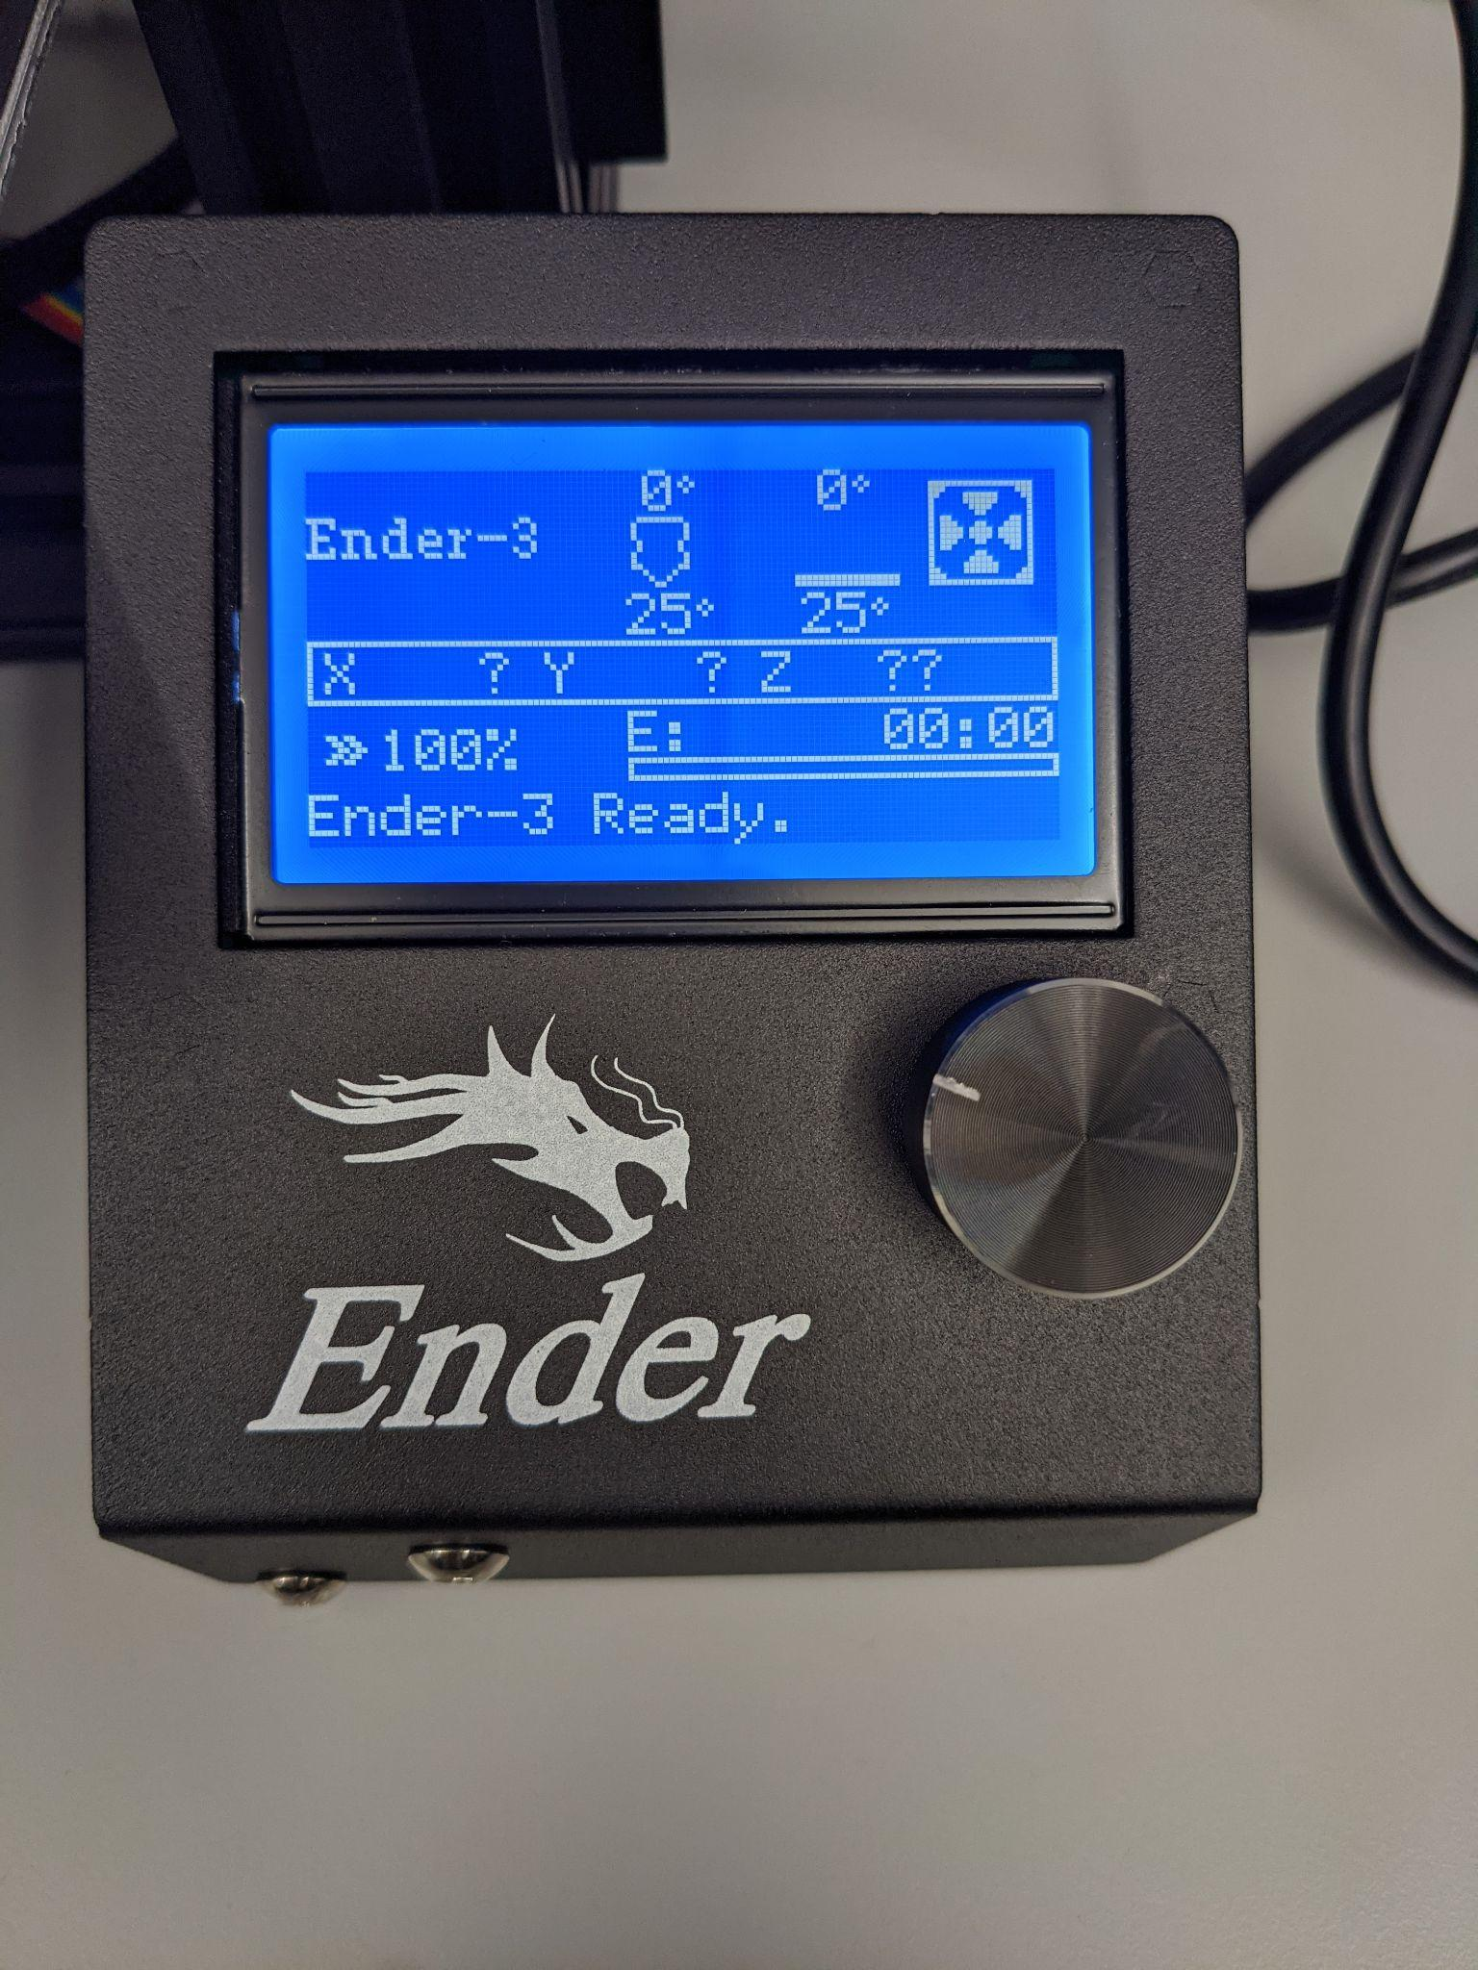
Phone Application
Perform all the tasks of the original software
Developed in Android Studio using Kotlin Programming Language
Printer Name
Select Print
Start Print
Bed Temperature 0°
Extruder Temperature 0°
Extruder Position 0.0.0
Fan Speed 0
Last updated: 0s
Printer Status:
Server Status:

Slide 10

Server
Intercommunication between mobile application and physical printer
Stores a library of previous prints

Slide 11





User Interface Model
Printer Name
Printer Name
Printer Settings
Print Library
Print Library
model_bridge
Printer Settings
Bed Temperature
Upload Print to Library
Upload Print to Library
Select Print
Select Print File
Select Print File
Print Library
Extruder Temperature
Select Print File
Settings
Home Position
Select from Files
Search Library
Select from Library
Printing
18%
Start Print
Search Library
model_ship
model_ship
model_plane
model_plane
Bed Temperature 0°
Extruder Temperature 0°
Extruder Position 0.0.0
Last updated: 0s
Skeleton_hand
Skeleton_hand
Bed Temperature 0°
Extruder Temperature 0°
Extruder Position 0.0.0
Fan Speed 0
Last updated: 0s
mini_whale
mini_whale
Printer Status:
Server Status:
Printer Status:
Server Status:
Revert
Print
Print

Slide 12
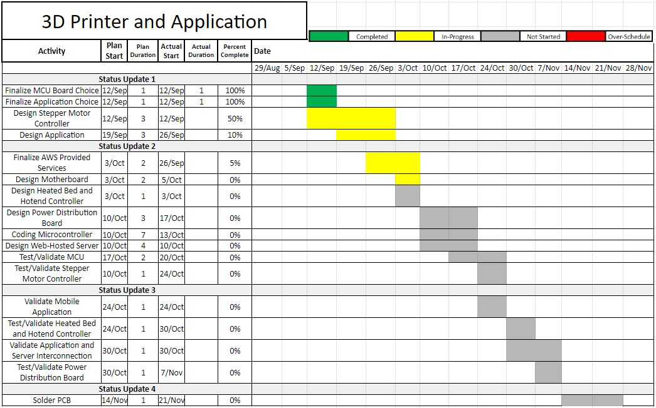
Execution Plan

Slide 13
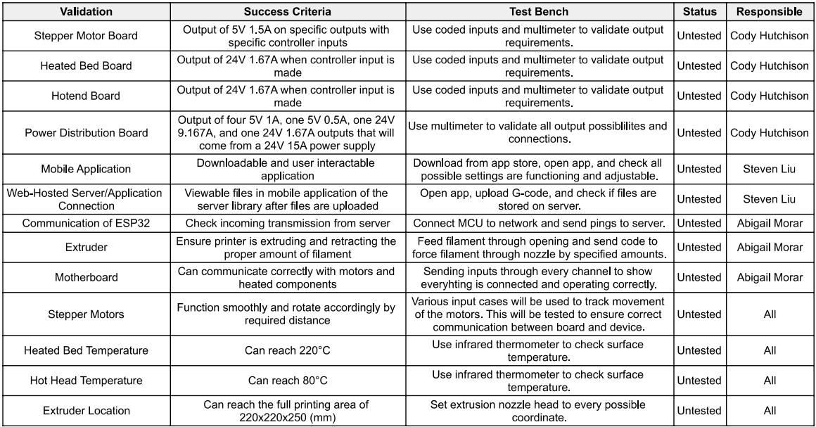
Validation Plan

